Slide 1

Lesson 5 CN4005: Group Work & Diversity
Dr Fadi Safieddine
1
Dr. Fadi Safieddine copyright 2024

Slide 2

Lecture content
Value of teamwork in a group
Difficulties working in a group
Roles within a group
What makes a good team player
Having a back-up plan
What makes a team work well
Working with diverse people.
Final reflection

Slide 3
Employer requirements for jobs
1.Value of teamwork in a group
Accounts Trainee: HALIFAX, WEST YORKSHIRE
Eagerness to work as the part of a successful team
Planning Manager: LEEDS, WEST YORKSHIRE,
Good team player with the ability to work closely with colleagues and other departments at all levels
Purchase Ledger Supervisor: Halifax, Yorkshire,
The purchase ledger clerk will be a good team player, as well as a leader of people and lead by example.
`
Sales Consultant, Pontefract, WF8 4PR
Work well as part of a team
Research and Knowledge Transfer Officer, UoB,
Strong team-working skills, strong interpersonal and communication skills.

Slide 4
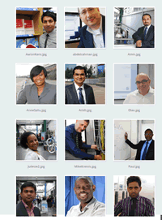
Working in London:
1.Value of teamwork in a group
Diverse people
Different values
Different approaches
Transient workforce
Continuation and progress
Clear management structure
Strong communication
Clear teamwork ethos

Slide 5

Working with other students:
1.Value of teamwork in a group
Assignments
Presentations
Lab work
Projects
Work placements

Slide 6
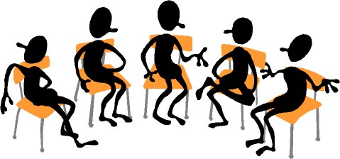
2.Difficulties working in a group
What difficulties have you had
working with other people in a group?

Slide 7
Characters
2.Difficulties working in a group
Characters | Advantage | Disadvantage
Dominant and loud | Motivated and would drive the team forward | Could be considered bullying and may end up doing all the work.
Inclusive (‘we’ and ‘all’) | Brings people together and allows excellent negotiator. | May end up being too concerned about the ‘group’ than the ‘project’.
Polite and makes suggestions | Ideal team play who is happy to follow on their activities. | Could be overwhelmed or overshadowed.
Offensive and abrupt | Rebellious ideas can be source of creative ideas. | May offend group members and get sided.
Shy or bored character. | Listeners and participators | May need prompting and may feel outside the group

Slide 8
End of Part 1
Activity 5.1. You have all worked in groups in the past, working with friends at school on an assignment or project. Indicate the most common reason why the team did not perform to its full capacity.
Conflicts between team members
Lazy team leader: Team leader expects others to do the work for them.
Team leader too nice to everyone, even those not doing the work.
Poor communication: Not discussing changes or progress with the team.
Authoritarian team leader: “My way or the highway!”

Slide 9
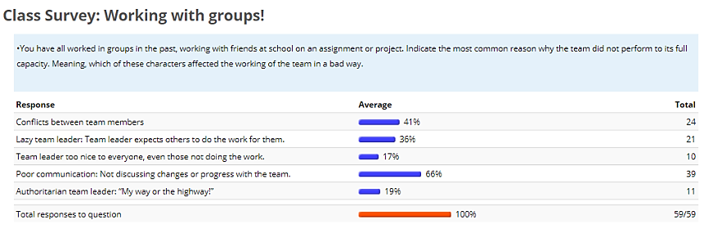
Results of last term survey:
2.Difficulties working in a group

Slide 10
Tell me what you think:
2.Difficulties working in a group
Part 2

Slide 11
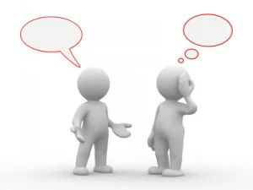
Two main issues:
2.Difficulties working in a group
Communication
To members of the group
Written work
Presentations
Commitment
Attending meeting
Participation in meetings
Fulfilling promised work

Slide 12
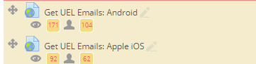
Exchanging Contacts
2.Difficulties working in a group
UEL Email (first means of contact).
Set up to get UEL emails on your phone
Found under week 1

Slide 13
Exchanging Contacts
2.Difficulties working in a group
Personal Email
MS Teams Chat
WhatsApp (optional)
Very important in your first meeting to agree on a time when everyone is able to meet once a week.
Ideally, pick time before or after the class
Or on the same day.

Slide 14
Setting up meetings
2.Difficulties working in a group
Use MS Teams to set up meetings.
It is very simple:
Go to your Calendar, click on a time in the future when everyone is free to meet.
Select the students IDs
Send – next is demo on how to arrange a meeting with your group.

Slide 15
Creating a meeting on MS Teams

Slide 16
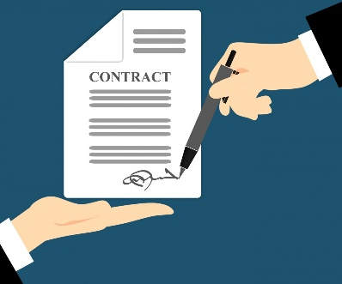
Create your contract
2.Difficulties working in a group
Next is my suggestion:
You could agree with my suggestions
You could start your own protocols of communication and reporting.
You should agree on key things:
The outcome you want.
Team structure.
How the work will be distributed.
How do you like to work (we will come back to it later)
What procedures will you take to ‘remove’ a group member for failing to participate or contribute?
This has to be typed in an email and sent to everyone!

Slide 17
End of Part 2
Activity 5.2. How long would you wait before raising the alarm that a group member is not participating? (Select as many)
Two days
After they miss three meetings without contact.
When they fail to respond to three contacts and you have waited a week.
You meet as a group and agree to suspect the member for failing to participate.
Also, you can make your own agreement but it has to be in writing.

Slide 18
Your responsibilities as a member
2.Difficulties working in a group

Slide 19
Your responsibilities as a member
2.Difficulties working in a group
If they are unable to attend:
Let the group members know if they are unable to attend.
Send them any work (even if incomplete) to show you are still engaging.
Expect an email from a member with details of what ‘they have to do’.

Slide 20

Roles: Have it rotated?
3.Roles within a group
Chair or facilitator:
ensures everyone gets an opportunity to contribute in meetings and to task
ensures all important points are covered
Note-taker: Write what you agreed on.
Time-keeper:
keeps meetings moving
Group co-ordinator:
contact details
books room
produces and distributes meeting notes and agenda

Slide 21
Allocating roles
3.Roles within a group
Get to know your group to work out individual skills and qualities

Slide 22
A. Social skills and qualities
4.What makes a good team player
Active listening
Social perceptiveness
Self-monitoring
Selflessness
Warmth and co-operation
Patience and tolerance

Slide 23
B. Inter-personal and self-management knowledge, skills and abilities
4.What makes a good team player
Conflict resolution
Collaborative problem solving
Communication
Goal-setting and performance management
Planning and task co-ordination

Slide 24
Backup plan?
5.Having a back-up plan
Imagine you are in a project, and someone falls ill.
They might not be able to complete their bit of the project!
What will you do?

Slide 25
Continuation:
5.Having a back-up plan
Keep each other updated at meetings
Ensure any relevant information is shared amongst the group
Allocate a substitute to, e.g., deliver the
presentation/ write up the final report/ perform
the lab practical.

Slide 26
6.What makes a team work well
Organisation
Having a clear agreement (plan)
Being positive and open to the group experience
Being prepared
Having a Plan B

Slide 27
Summary of the points:
1.Value of teamwork in a group
2.Difficulties working in a group
3.Roles within a group
4.What makes a good team player
5.Having a back-up plan
6.What makes a team work well

Slide 28
End of part 3
Activity 5.3. What makes a great team? (Tick as many relevant items):
To be organised and prepared
Have a backup plan if there are problems.
Having a clear team structure.
Having an agreement from the start with objectives, protocols, including actions in case of slacking.
Being positive and constructive in your work.

Slide 29
Diversity and inclusivity

Slide 30
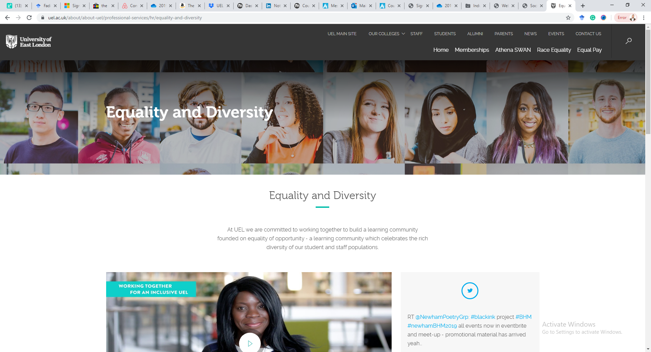
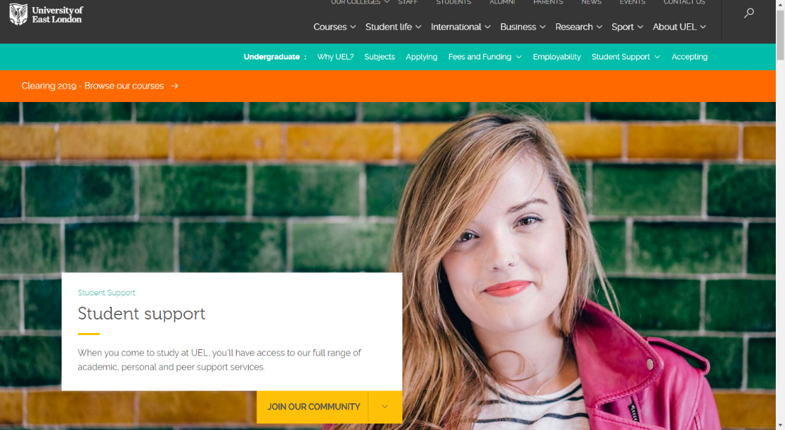
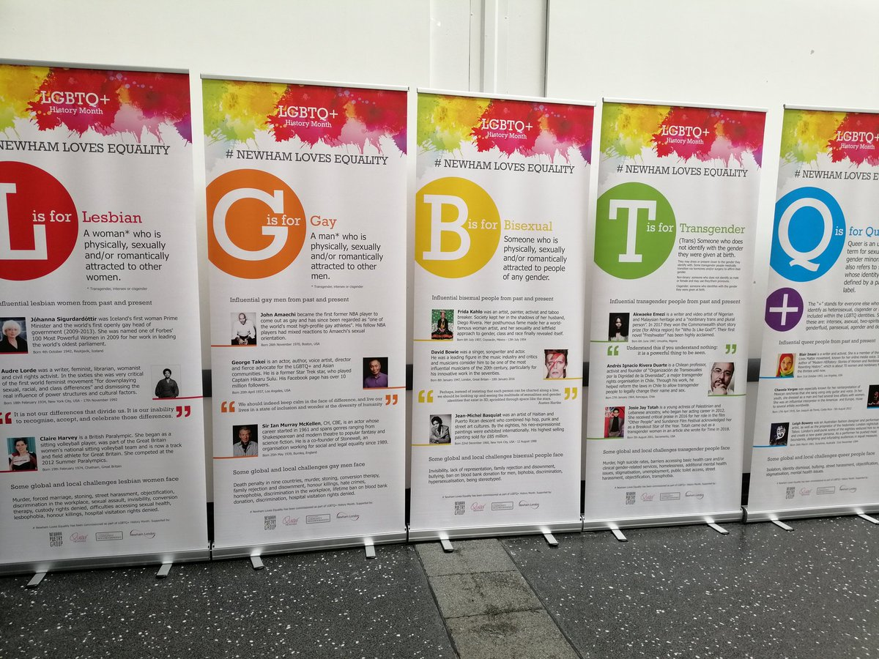
Diversity and inclusivity

Slide 31
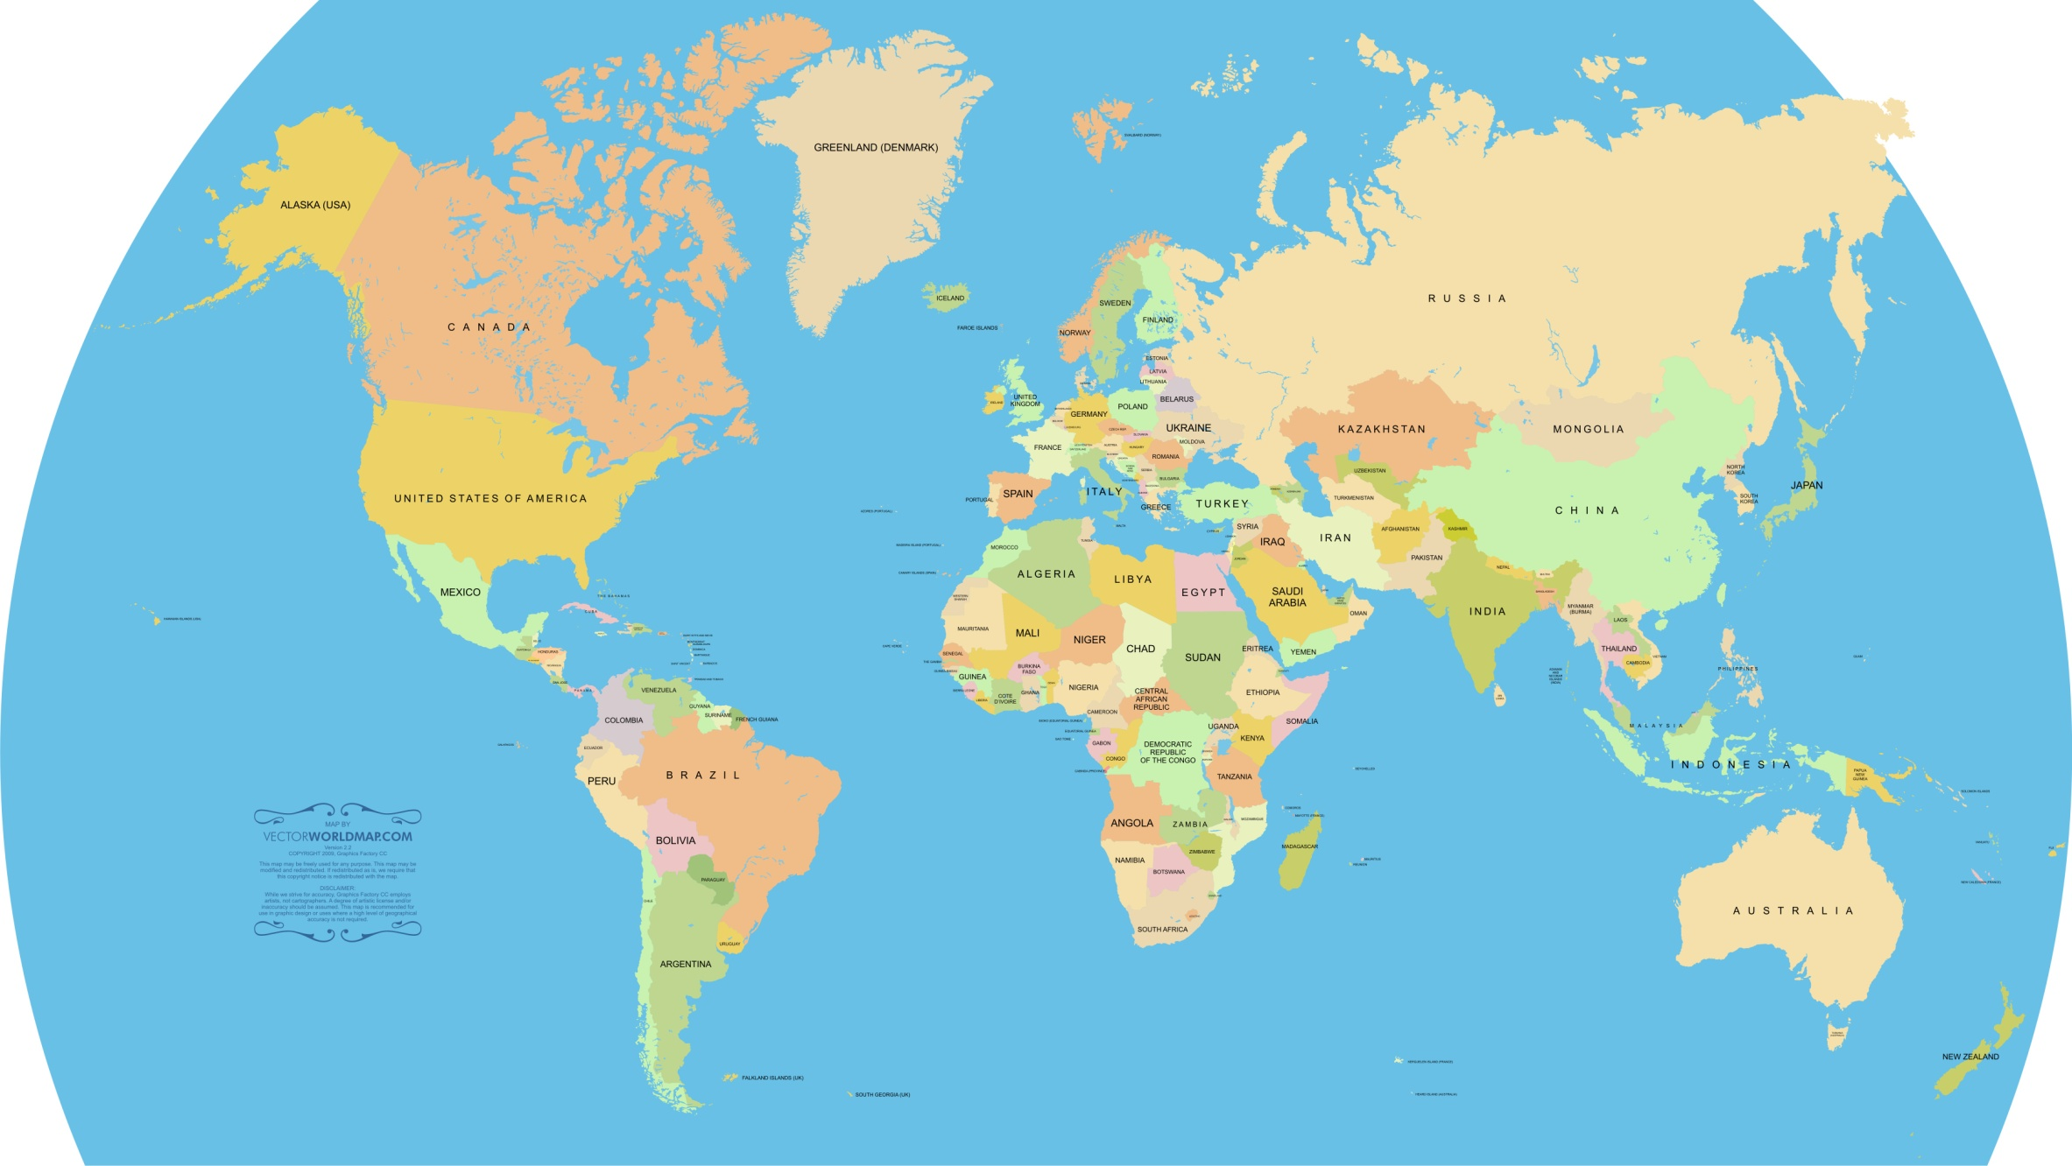
What is this?

Slide 32
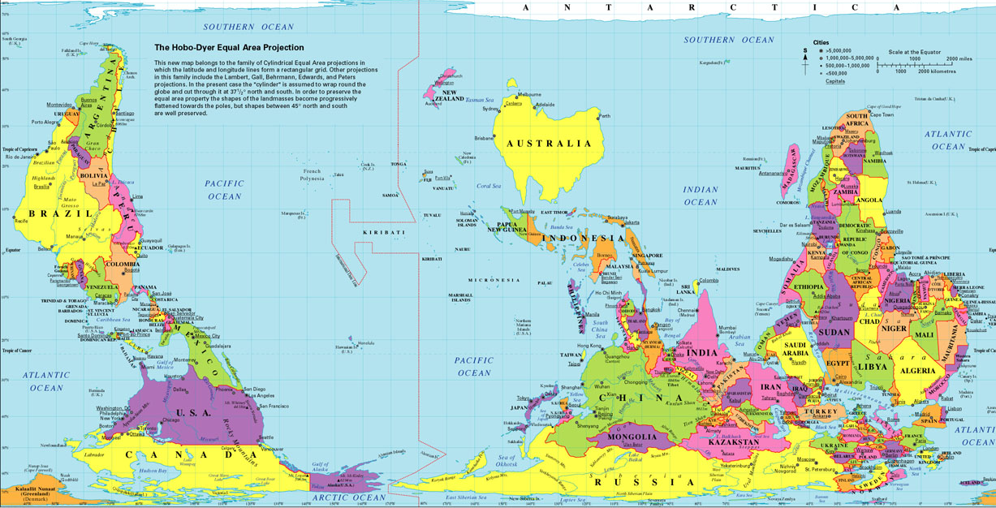
What is this?

Slide 33
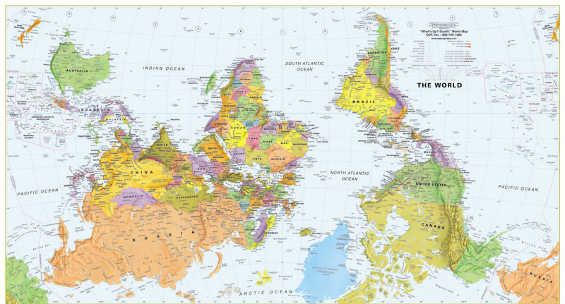
What is this?

Slide 34
Perspective?
What it means to be egocentric?
What it means to be able to put yourself in the other person’s shoes?
Different people may have different perspectives, it does not mean they are wrong.

Slide 35
What do they mean?
Diversity is about recognising and celebrating differences.
Inclusivity is understanding and catering for the different potentials, needs and resources of people– levelling the field.

Slide 36
Protected Characteristics (9PC’s)*
Age | Gender | Race
Disability | Sexual Orientation | Religion or Belief (or a lack of belief)
Gender Reassignment | Pregnancy and Maternity | Marriage / Civil Partnership
* Equality Act 2010

Slide 37
Protected Characteristics (9PC’s)*
Age | Gender | Race
Disability | Sexual Orientation | Religion or Belief (or a lack of belief)
Gender Reassignment | Pregnancy and Maternity | Marriage / Civil Partnership
* These are called ‘invisible EDIs’

Slide 38

How a diverse team work?
3 Minute video:
https://products.office.com/en-gb/yammer/yammer-overview

Slide 39
Keep an eye on the diversity of the workforce and teams.

Slide 40
End of part 4
Activity 5.4. Reflect on the video you just saw on “promoting Yammer”, which of the characteristics of individuals did you see:
Age (Employees of all ages)
Gender (Females in different managerial roles)
Race (Diverse and covering different managerial roles)
Disability
Sexual Orientation (Rainbow)
Faith
Pregnancy (parenting)

Slide 41
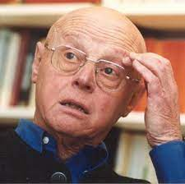
Geert Hofstede
IBM Manager
Most cited social psychologist researcher
Focused on Organisational culture

Slide 42

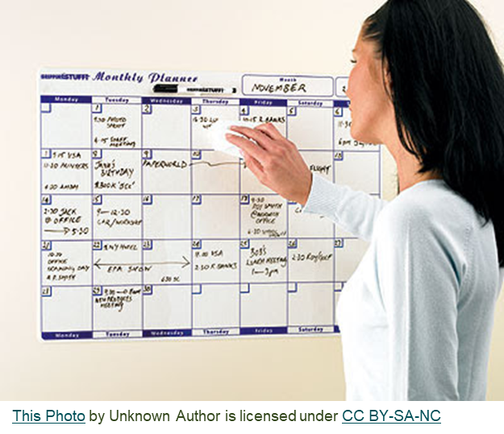
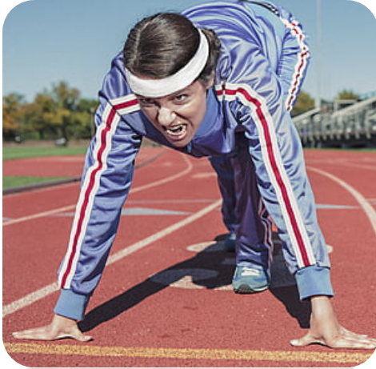
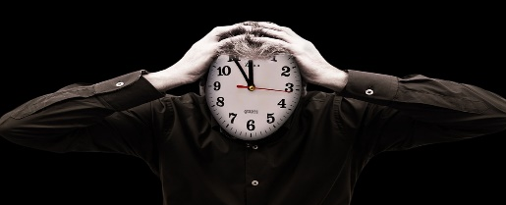
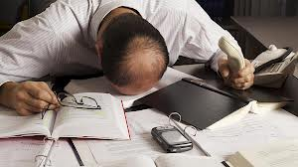
Fadi’s Observation
Four categories of students:
Terminator
Planner
Sprinter
Crusher
Terminator Planner
Sprinter Crusher

Slide 43

Fadi’s Observation
Terminators:
Cannot wait to start the assignment.
Wants to finish it as soon as possible because they have other priorities.
Cannot sleep well if they do not feel they are in control of the situation.
Gets joy from finishing early!
This Photo by Unknown Author is licensed under CC BY-SA-NC

Slide 44
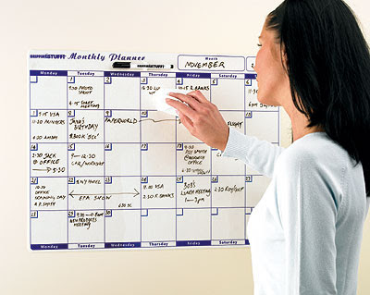
Fadi’s Observation
Planners:
Review the assignment.
Breaks it into tasks.
Assesses how long it takes.
Does a little bit every week.
Keeps an eye on it.
This Photo by Unknown Author is licensed under CC BY-SA-NC

Slide 45
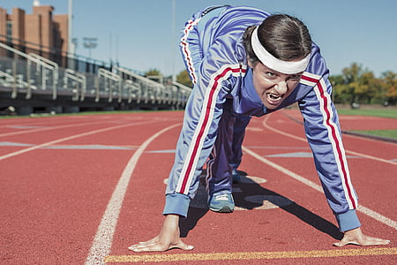
Fadi’s Observation
Sprinters:
Start the assignment a few days before, maybe a week before.
Can only focus on one item at a time.
Would complete about 50% of the work before the day of the deadline.
Completes the remaining 50% on the day of the deadline

Slide 46

Fadi’s Observation
Crushers:
Can only focus when there is a sense of urgency.
Works much more efficiently under pressure.
May have time management issues.
Start reading the assignment 24 or 48 hours before it is due.
Has passed many assignments this way and feels it is a more efficient and effective use of their time.
This Photo by Unknown Author is licensed under CC BY-NC-ND

Slide 47
One size does not fit all!
It is possible that maybe you are a Terminator for some subjects you like and a Crusher for subjects you dislike!
You might be a Planner for family events but a Sprinter for university assignments.
You may vary your approach if you are doing an individual assignment (Terminator) or a group assignment (Planner).
When busy, Terminator may be forced to move to Planner, Planner into Sprinter, and Sprinter into Crusher!
But in many cases, students tend to stick to what they believe works best for them in assignments.

Slide 48
Which category do you believe you are?
Four categories of students:
Terminator
Planner
Sprinter
Crasher

Slide 49
Which category do you believe you are?
Four categories of students:
Terminator
Planner
Sprinter
Crasher
Terminator Planner
Sprinter Crusher
This Photo by Unknown Author is licensed under CC BY-NC-ND

Slide 50
Which category do you believe you are?
Why is it important to acknowledge this?
It can help you evaluate your approach better.
It may help you see if you prioritise the right things and have a balance.
May help you plan group work better! (Next slide)

Slide 51
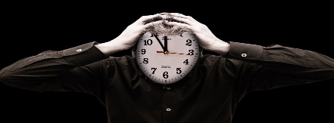
Knowing your category may help better group working:
Class discussion:
Would it help if all group members belonged to the same category?
Would it help to have a mix of students?
Would it help reduce conflicts within the group if students identify their approach right from the start?
Terminator Planner
Sprinter Crusher

Slide 52
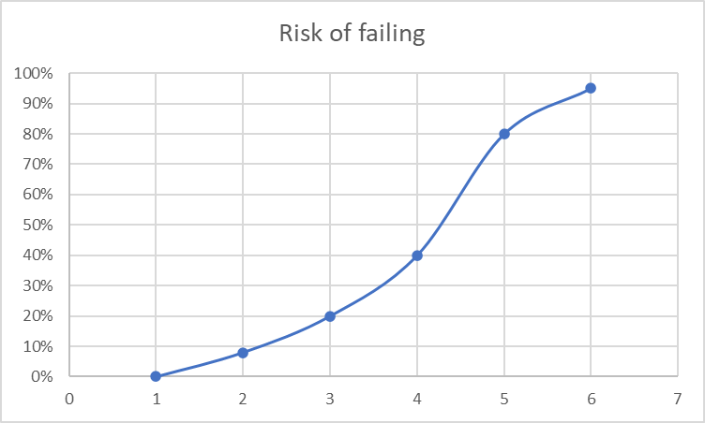
Knowing your category may help better group working:
Terminator Planner
Sprinter Crusher

Slide 53
References
Levin, P. (2005) Successful teamwork. Maidenhead: Open University Press.
West, M. (2004) Effective Teamwork. 2nd ed. Oxford: Blackwell Publishing.

Slide 54
Any questions?

